Slide 1

UNIVERSITY INSTITUTE OF TECHNOLOGY
RAJIV GANDHI PROUDOYOUGIKI VISHWAVIDYALAYA
BHOPAL,MP
MINOR PROJECT
ON
“UNIVERSITY MANAGEMENT SYSTEM”
SUBMITTED BY : ANUJ KUMAR KAUSHAL
ENROLLMENT NO : 0101CA191002

Slide 2
CONTENTS ->
About the Project
Objectives
Technologies Used
Work Flow
Data Flow Diagram(DFD)
E R Diagram
Tables
Front-end
Conclusion
Bibliography

Slide 3
ABOUT THE PROJECT :-
This project is basically aimed to manage a whole institutes and university based on students academics and examination criteria.
The system is an application that can be accessed throughout the institute with a proper login provided.
This system can be used as an application to manage the student information with their marks scored in the examination.
Students can check their results by entering their enrollment no and semester.
Students can also check and feed their attendance and also pay their admission fees through fee portal.
This system is totally based on java and sql.
There are two main portal i.e. Admin portal and Student portal.
In admin portal, only faculty will access and record all the student information, marks details, attendance.
In student portal, Student check their results by entering their enroll no and semester . They also check their attendance and pay fees also.

Slide 4
OBJECTIVE :-
The primary objective of this project is to manage the University System based on Students academic and examination criteria .
This Project provides the facility to maintain the details of the Students and faculty. Students can check their attendance, fees, result and access their marksheet and many more.
The scope of this project is to create a college app for managing the whole system.

Slide 5
TECHNOLOGY USED :-
This project is totally a Java based project. Java is used as a front-end tool and MySQL as a back-end tool.
Database-> MYSQL
Software-> NETBEANS IDE 8.2.
Coding-> JAVA

Slide 6
WORK FLOW :-
START
STUDENT
ADMIN
VERIFY
NO
ENTER USERNAME AND PASSWORD
RESULT
ATTENDACE
FEES
YES
MARKSHEET
STUDENT INFORMATION
FACULTY INFORMATION
MARKS INFORMATION
ATTENDANCE
STUDENT DETAILS
FACULTY DETAILS
MARKS DETAILS
ATTENDANCE DETAILS
STOP

Slide 7
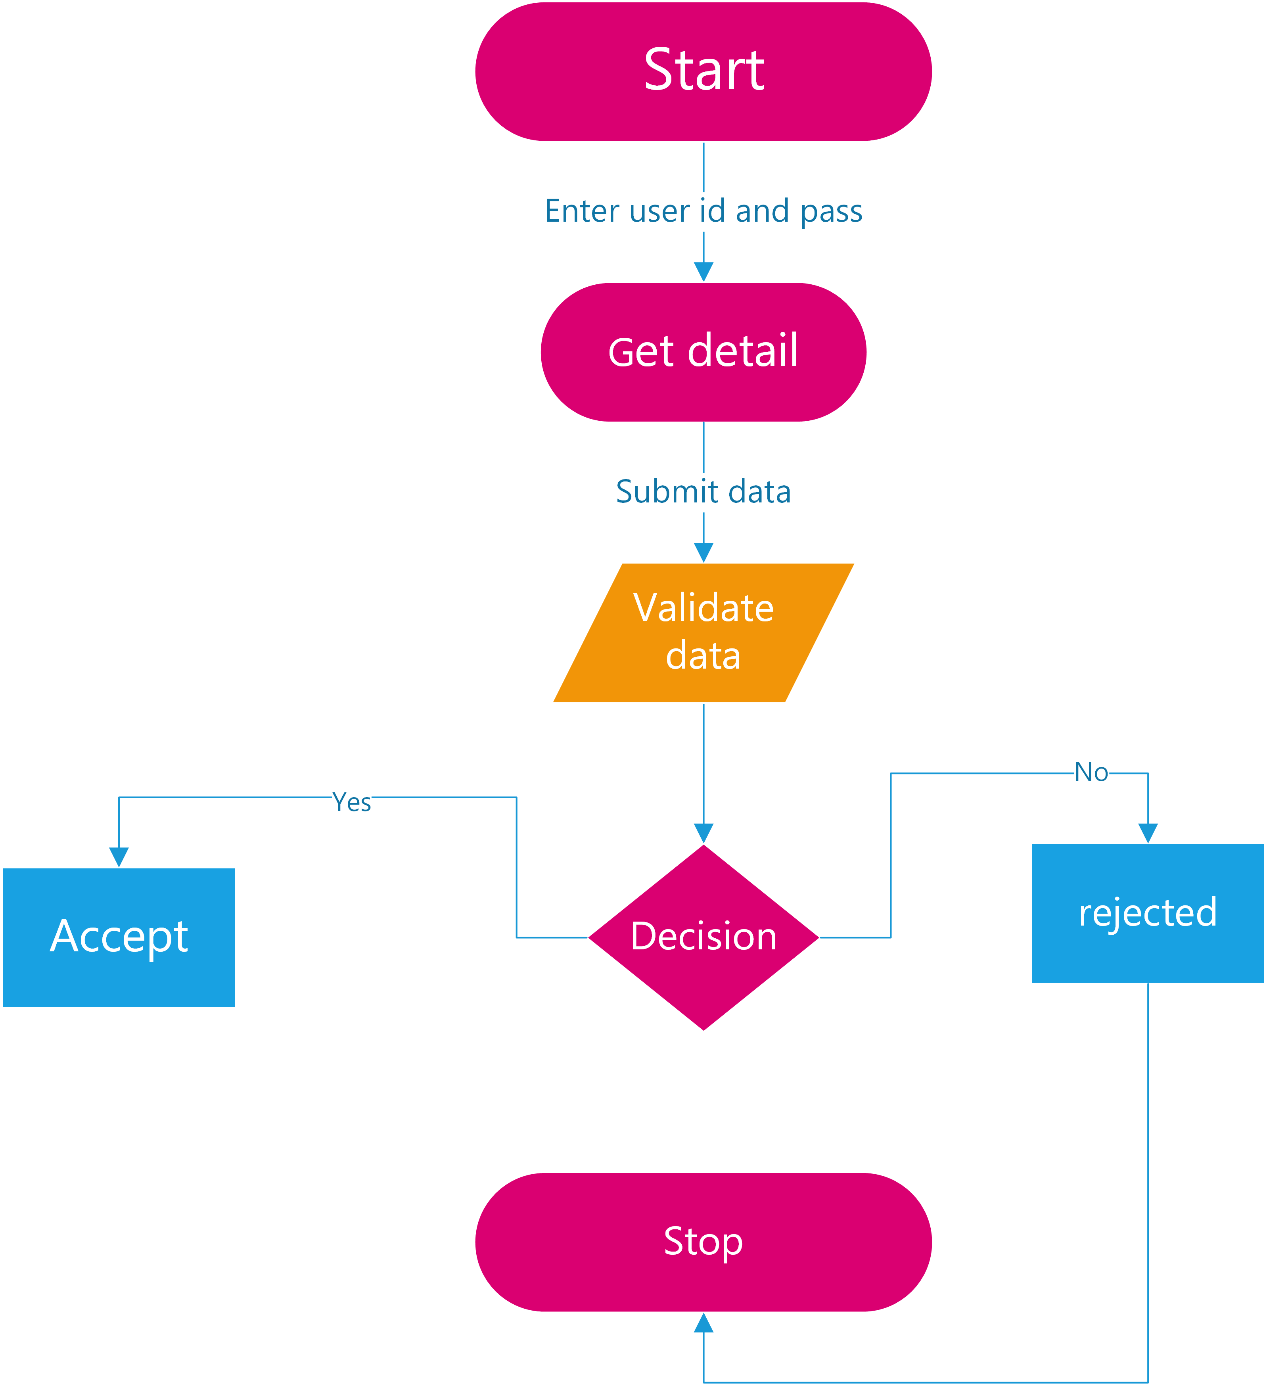
Data Flow Diagram

Slide 8
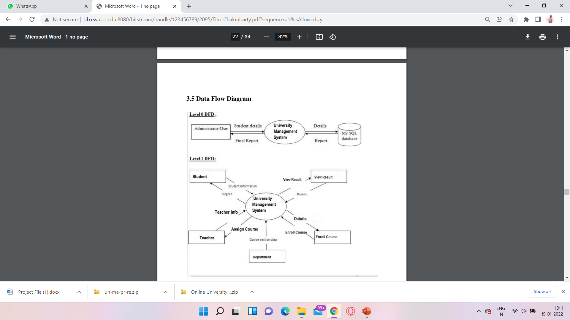

Slide 9
E-R diagram
The entity Relationship Diagram (ERD) depicts the relationship between the data objects. The ERD is e notation that is used to conduct the date modeling activity the attributes of each data object noted is the ERD can be described resign a data object descriptions.
The set of primary components that are identified by the ERD are :
· Data object
· Relationships
· Attributes
· Various types of indicators

Slide 10
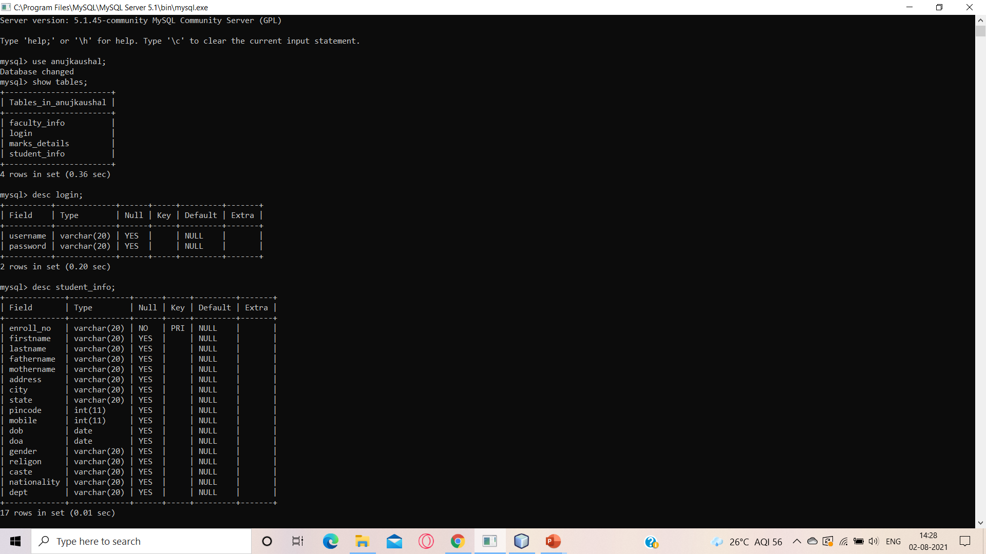

TABLES :-
LOGIN :-

Slide 11

STUDENT INFO :-

Slide 12
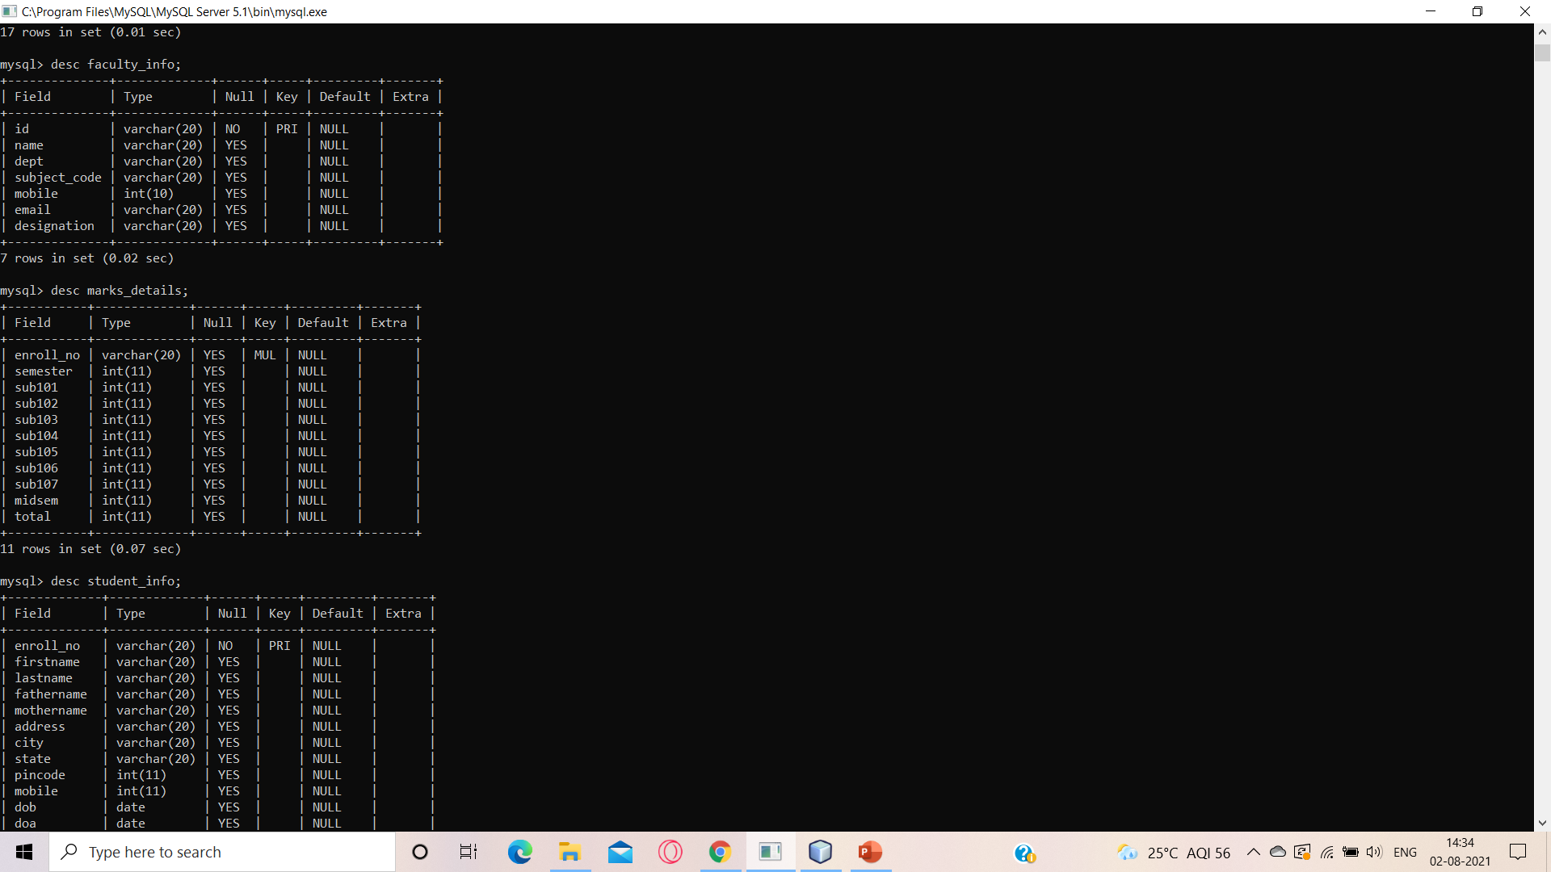

FACULTY INFO :-
MARKS DETAILS :-

Slide 13
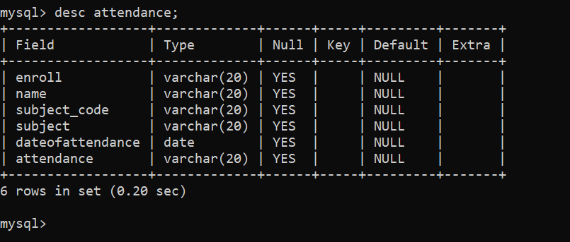
Attendance:-

Slide 14
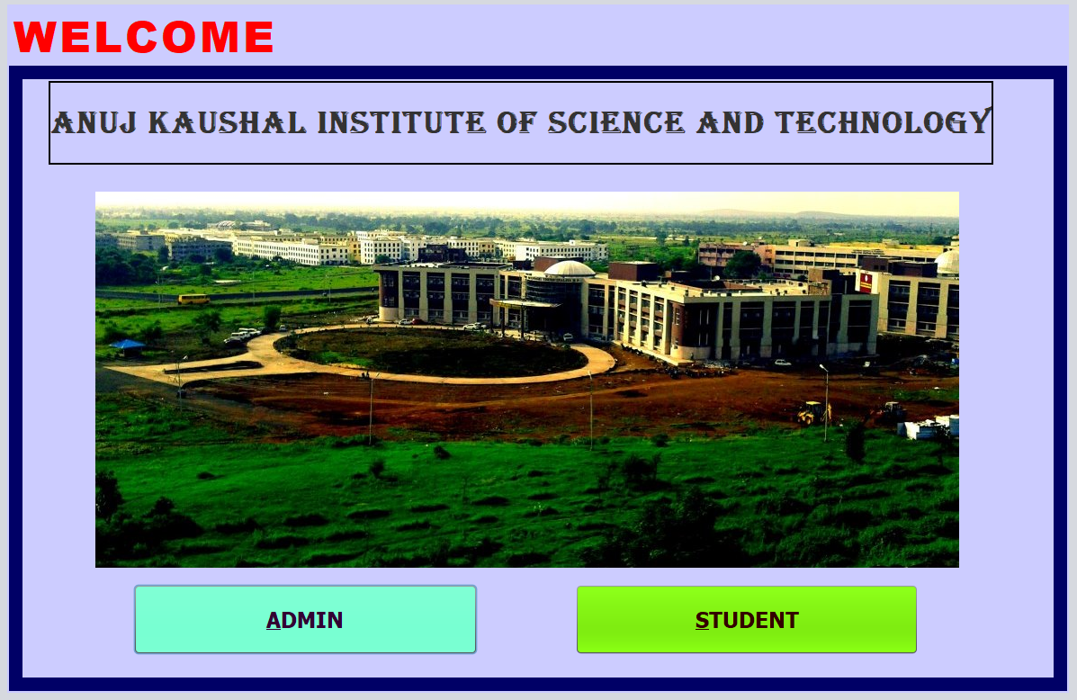
FRONT-END :-
INDEXPAGE

Slide 15
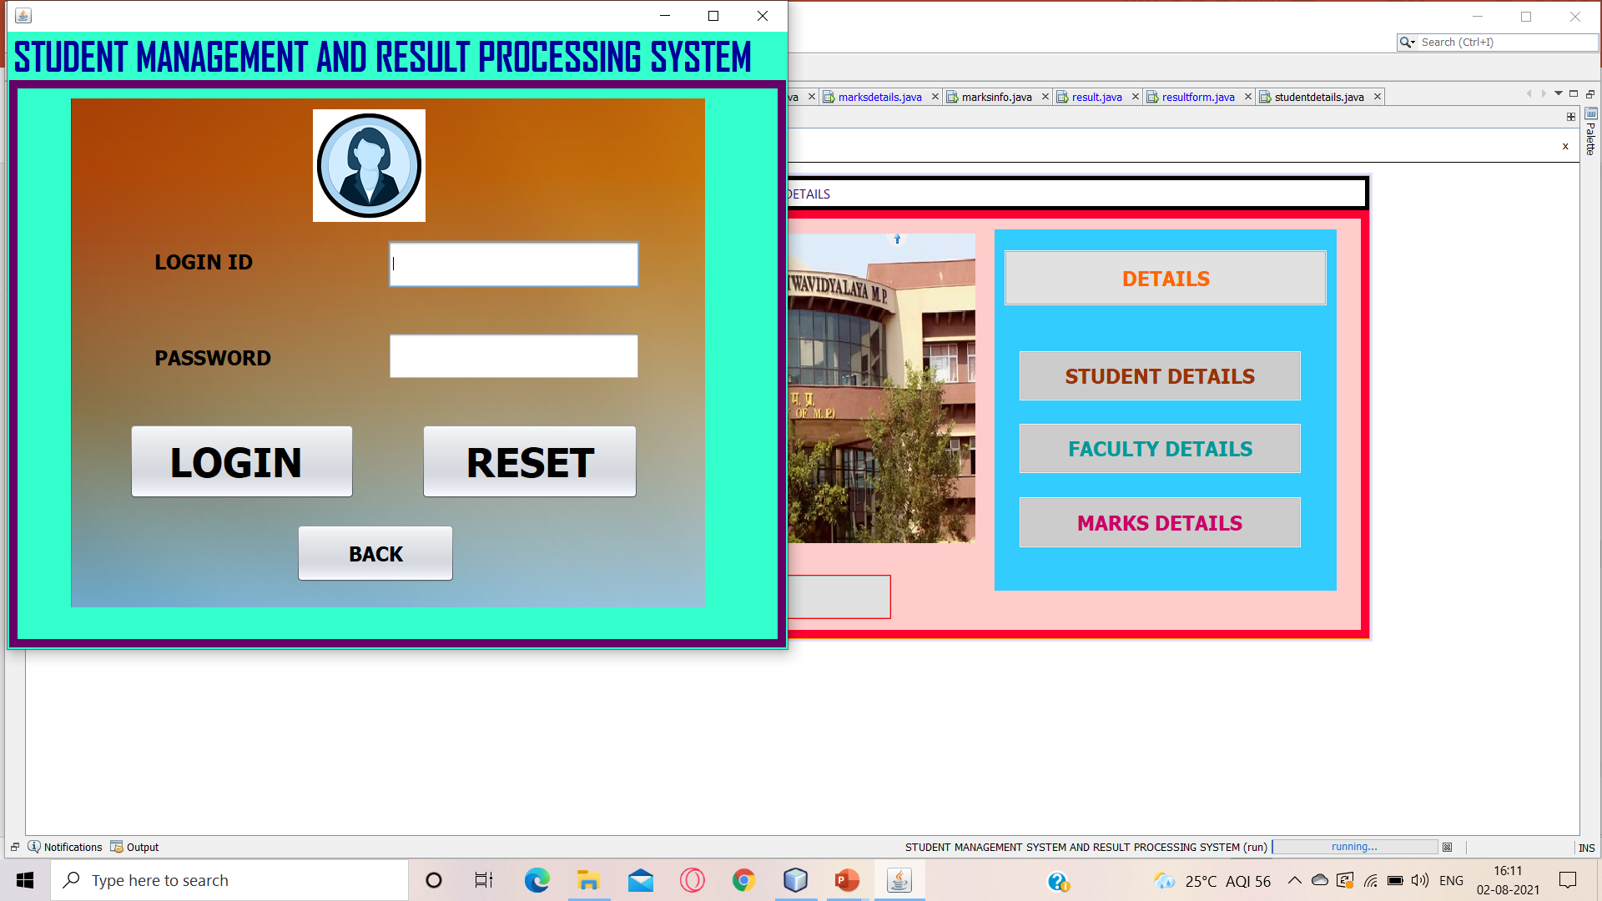
ADMIN PAGE :-

Slide 16
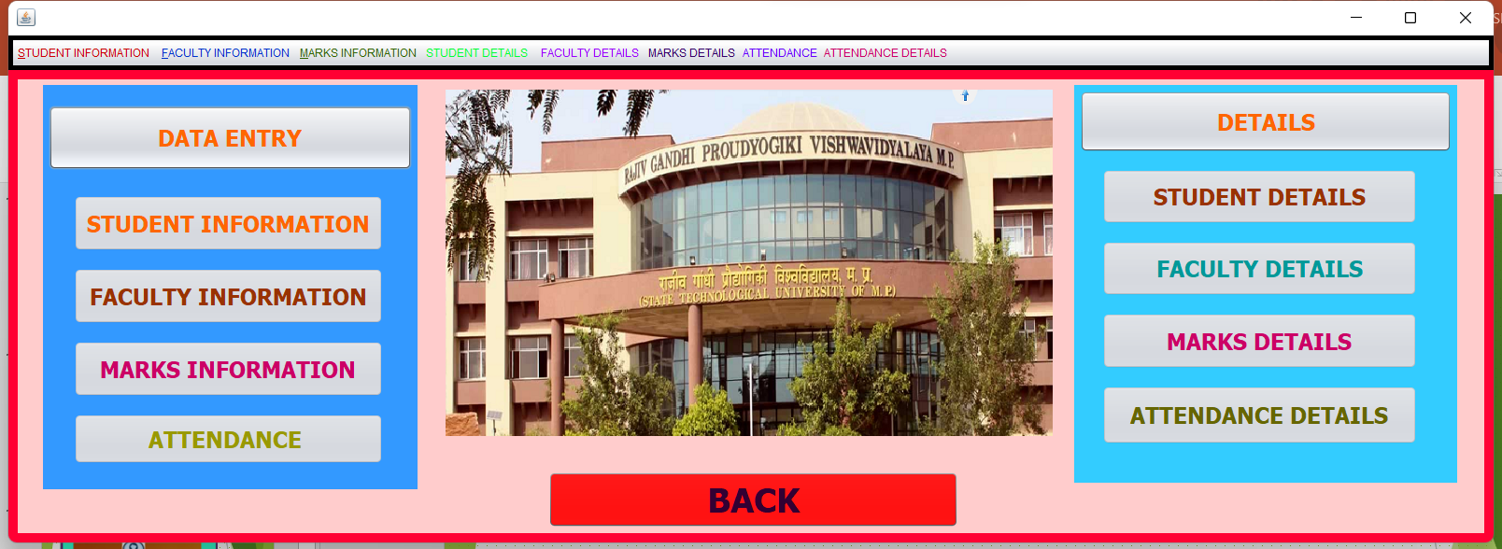
FRONTPAGE :-

Slide 17
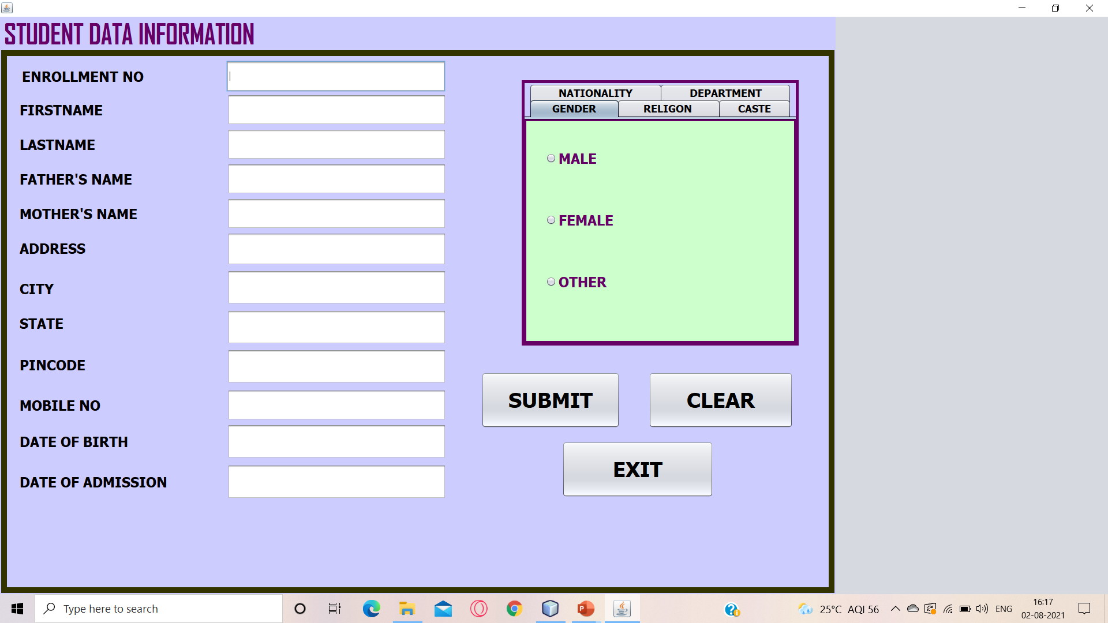
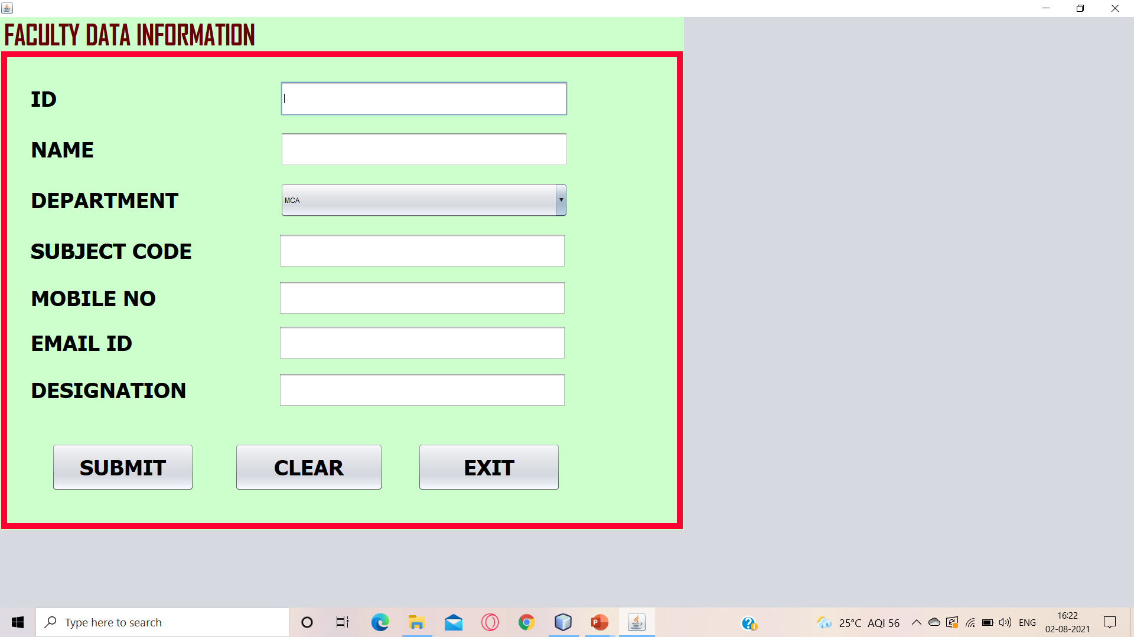
STUDENT INFORMATION :-
FACULTY INFORMATION :-

Slide 18
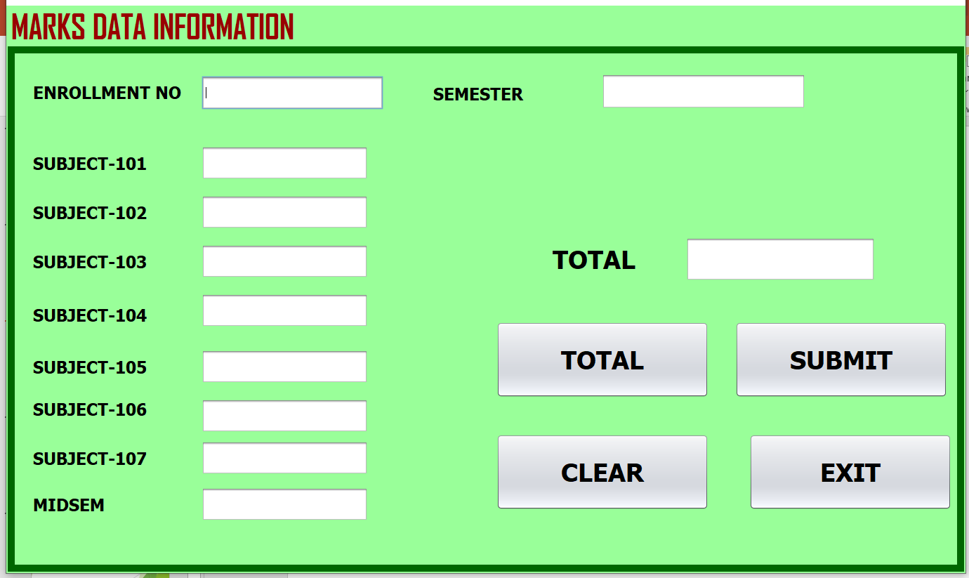
MARKS INFORMATION :-

Slide 19
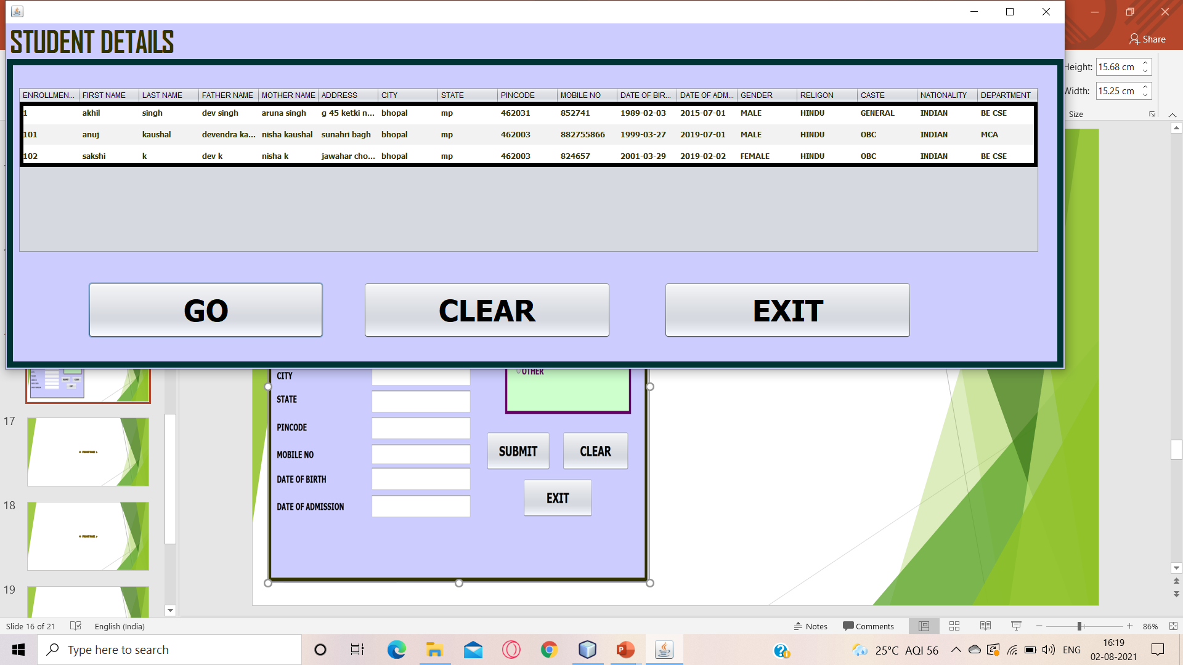
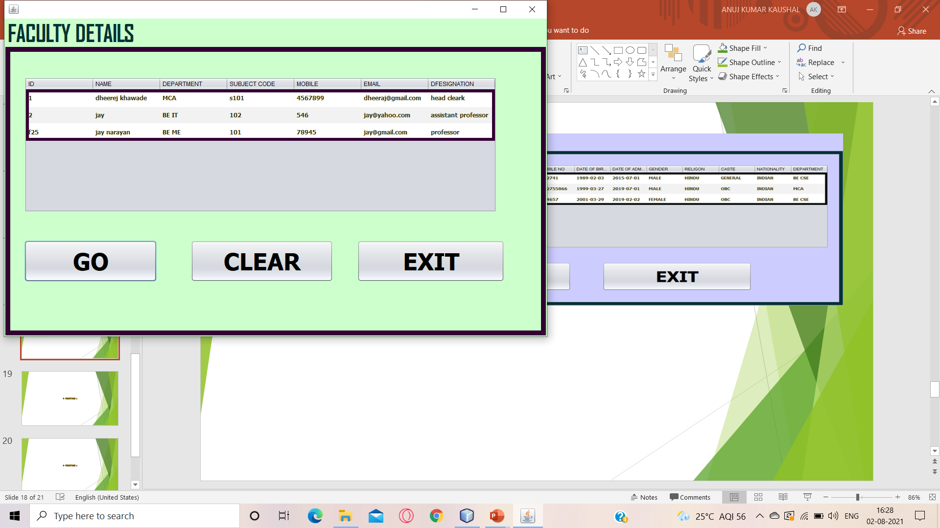
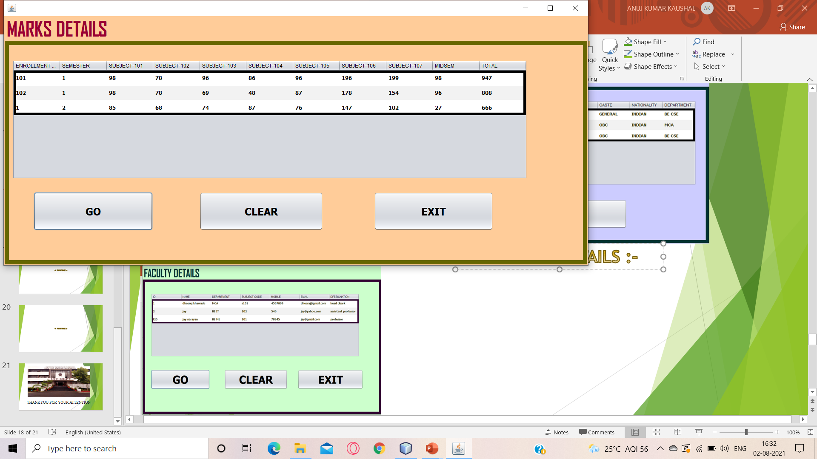
STUDENT DETAILS :-
FACULTY DETAILS :-
MARKS DETAILS :-

Slide 20
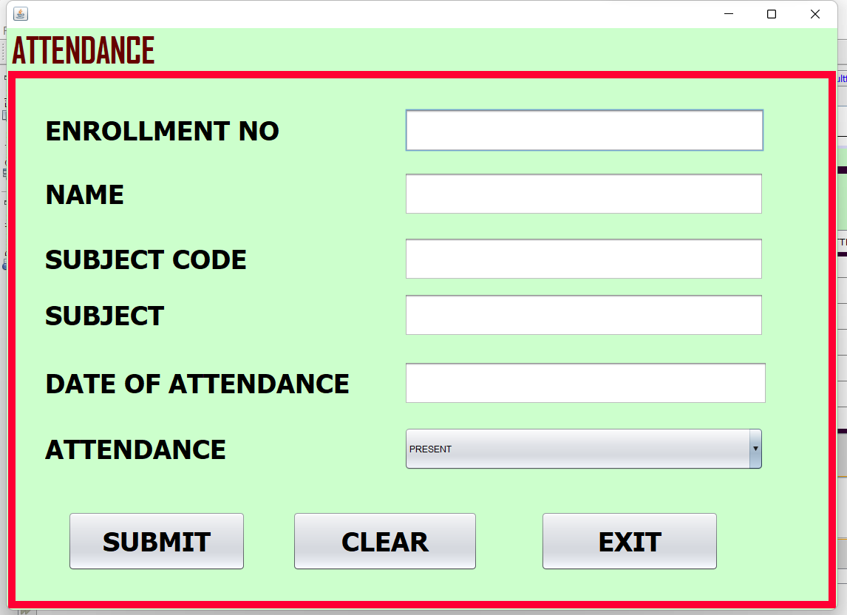
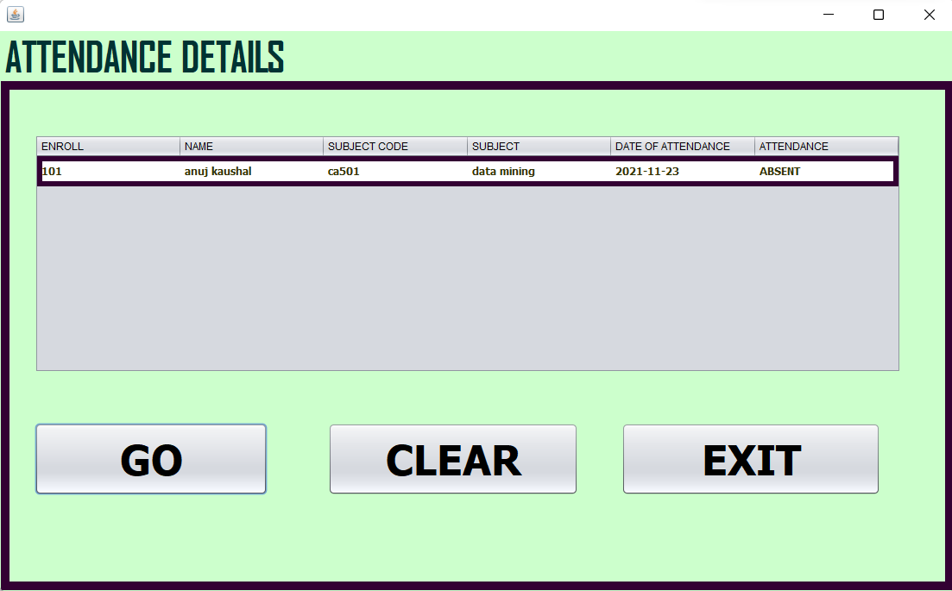
Attendance :-
Attendance details:-

Slide 21
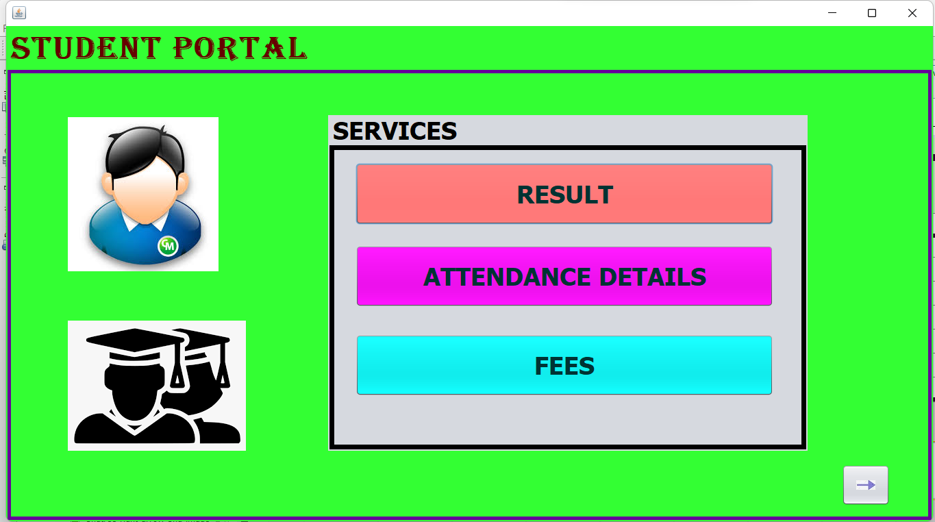

Slide 22
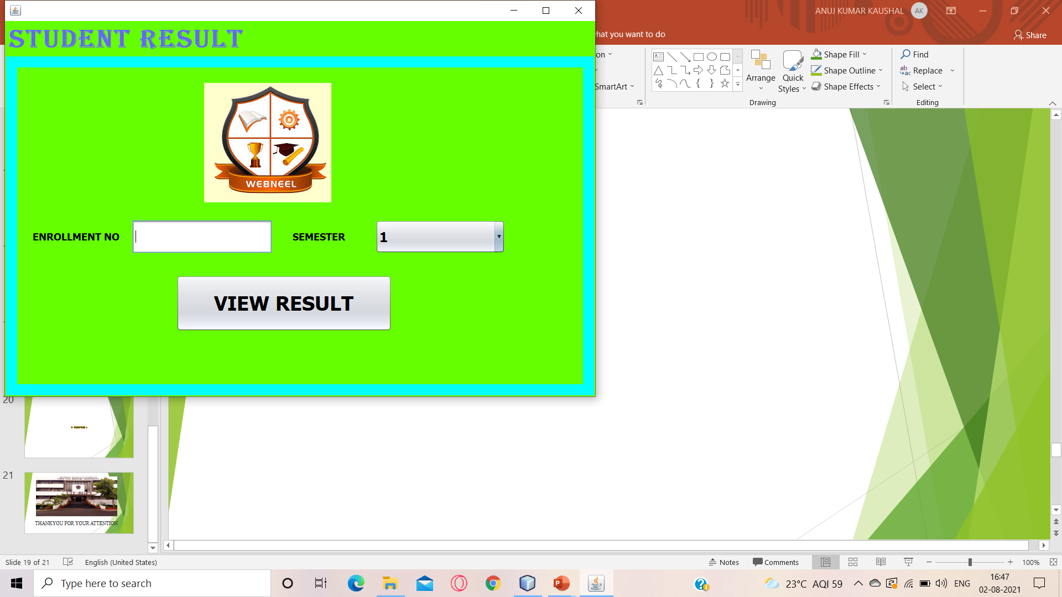
STUDENT PAGE :-

Slide 23
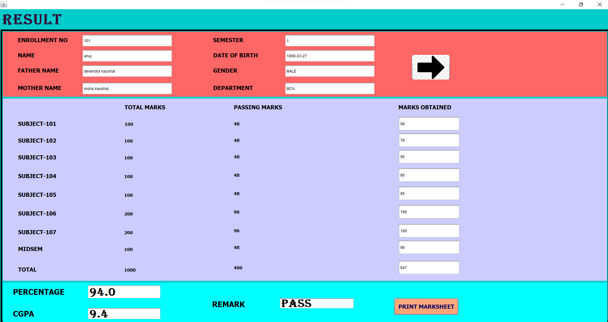
RESULT PAGE :-

Slide 24
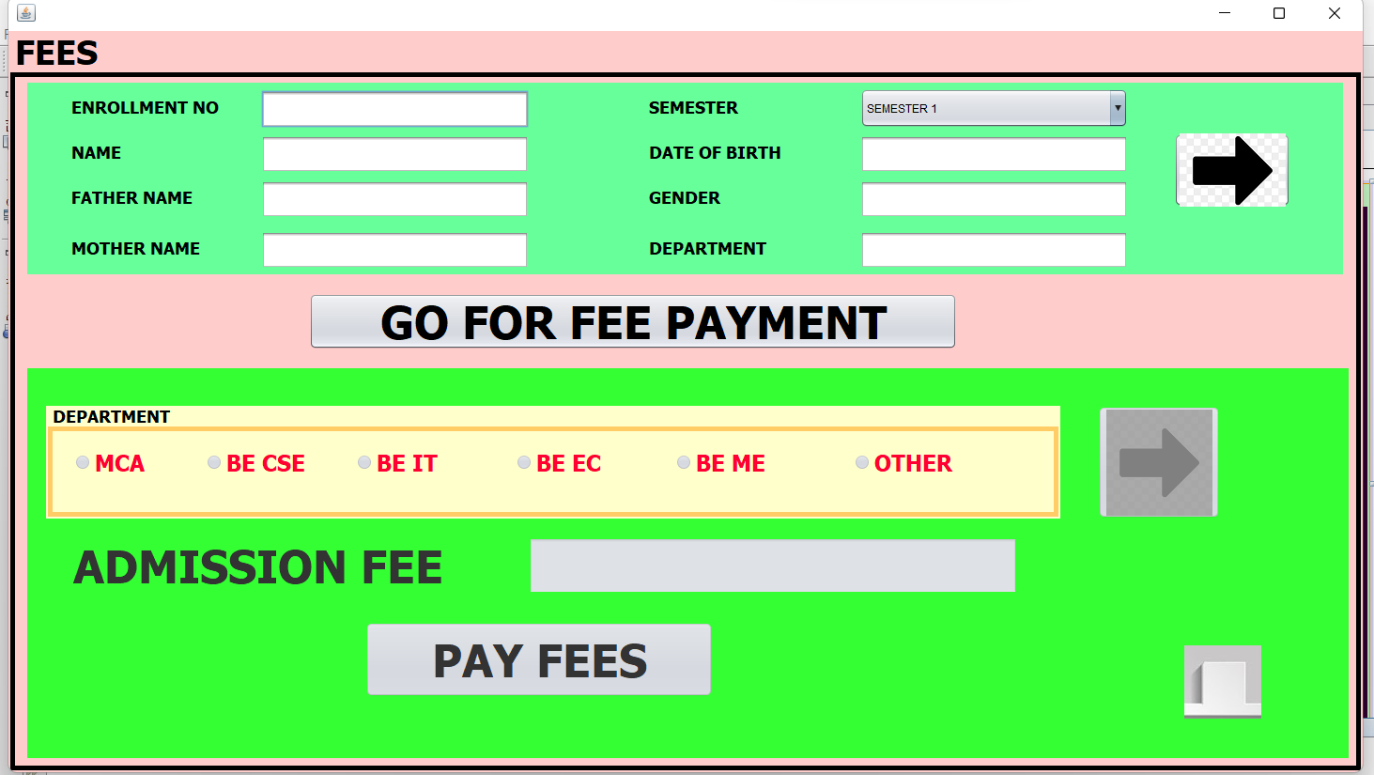

Slide 25
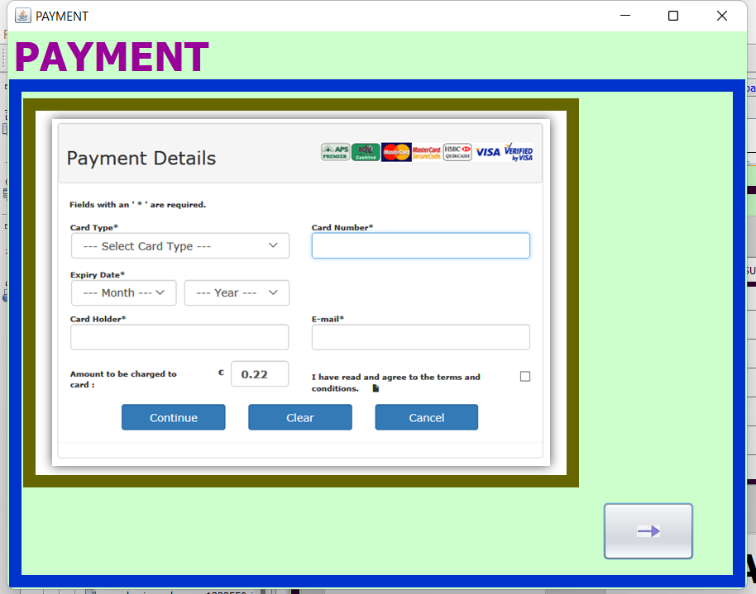

Slide 26
CONCLUSION:-
The project titled ‘UNIVERSITY MANAGEMENT SYSTEM’ was developed to manage the whole university system for students.
All the necessary output was created.
The system was found to be user-friendly to both students and admins.
The Architecture of the project provide an easy to use environment for the users.
The system was implemented successfully.
The manpower and the working hours needed to operate the system was less and comfortable.
It was seen to be more secure and effective.

Slide 27
BIBLIOGRAPHY :->
https://www.javapoint.com
https://www.youtube.com
https://www.w3schools.com
https://www.learning.tcsionhub.in
https://www.google.com
https://www.greaksofgreaks.com

Slide 28
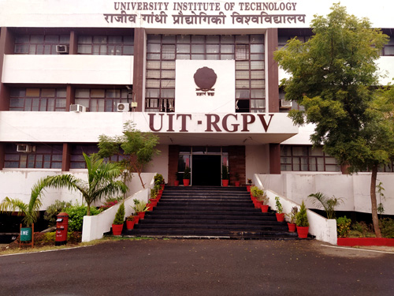
THANKYOU FOR YOUR ATTENTION

